Slide 1

Introduction to ML

Slide 2


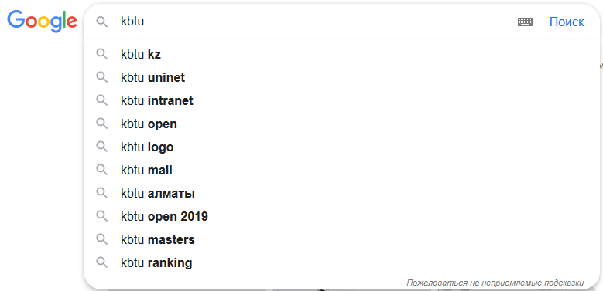

Slide 3
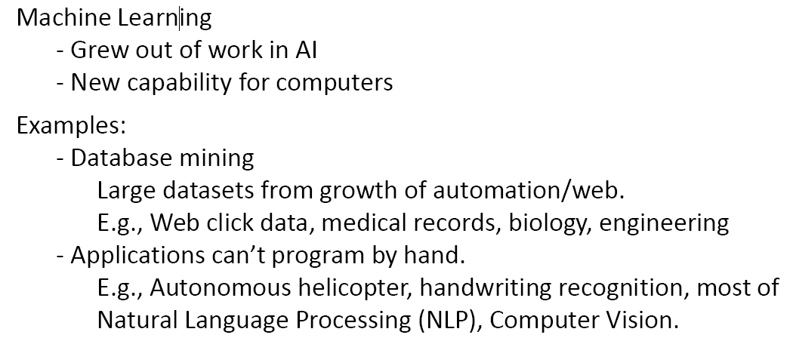

Slide 4
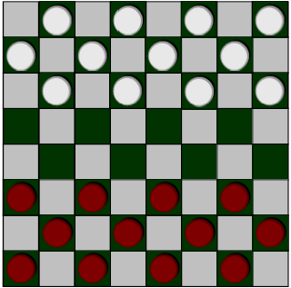
What is Machine Learning?
Arthur Samuel (1959). Machine Learning: Field of study that gives computers the ability to learn without being explicitly programmed.

Slide 5
What is Machine Learning?
Arthur Samuel (1959). Machine Learning: Field of study that gives computers the ability to learn without being explicitly programmed.
Tom Mitchell (1998) Well-posed Learning Problem: A computer program is said to learn from experience E with respect to some task T and some performance measure P, if its performance on T, as measured by P, improves with experience E.

Slide 6
What is Machine Learning (ML)?
“A computer program is said to learn from experience E with respect to some task T and some performance measure P, if its performance on T, as measured by P, improves with experience E.”
Suppose your email program watches which emails you do or do not mark as spam, and based on that learns how to better filter spam. What is the task T in this setting?
Classifying emails as spam or not spam.
Watching you label emails as spam or not spam.
The number (or fraction) of emails correctly classified as spam/not spam.
None of the above—this is not a machine learning problem.
T
E
P

Slide 7
Types of ML
Machine learning algorithms:
- Supervised learning
- Unsupervised learning
Others: Reinforcement learning, recommender systems.
Also talk about: Practical advice for applying
learning algorithms.

Slide 8
Supervised Learning

Slide 9
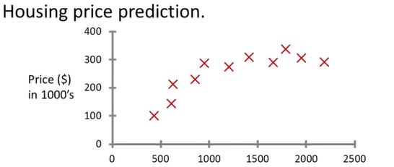

Supervised Learning on example
150
750
$$m^{2}$$
Supervised Learning
“right answers” given
Regression: Predict continuous
valued output (price)

Slide 10
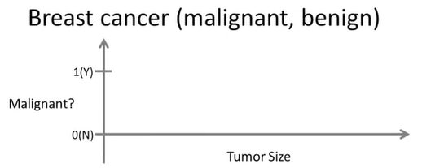
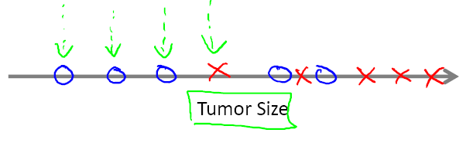
X
X
X
X
X
X
X
X
X
Classification
Discrete valued
output (0 or 1)

Slide 11
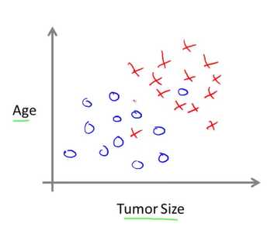
Clump Thickness
Uniformity of Cell Size
- Uniformity of Cell Shape
…

Slide 12
Example
You’re running a company, and you want to develop learning algorithms to address each of two problems.
Problem 1: You have a large inventory of identical items. You want to predict how many of these items will sell over the next 3 months.
Problem 2: You’d like software to examine individual customer accounts, and for each account decide if it has been hacked/compromised.
Should you treat these as classification or as regression problems?

Slide 13
Unsupervised Learning

Slide 14
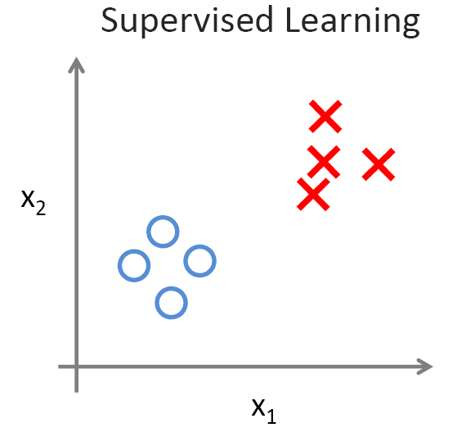
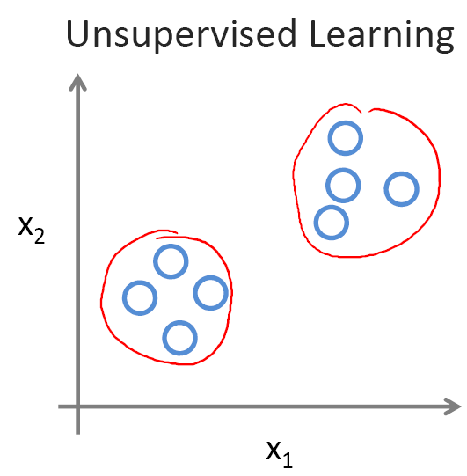

Slide 15


Slide 16
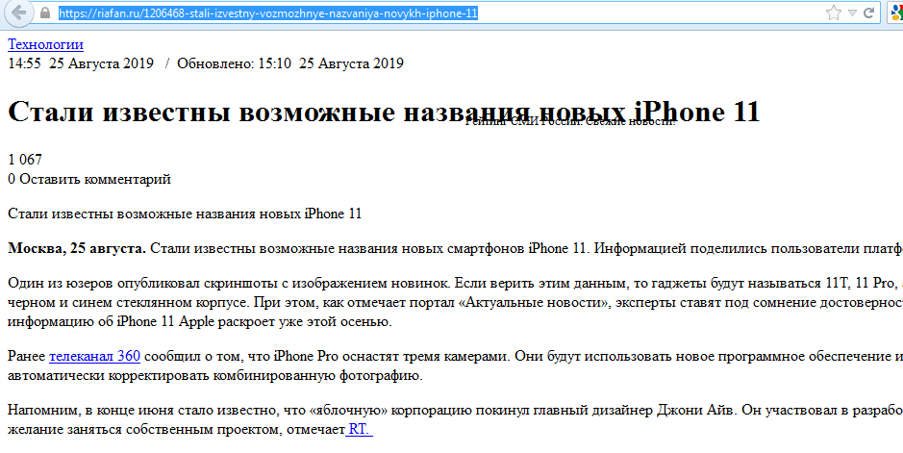


Slide 17
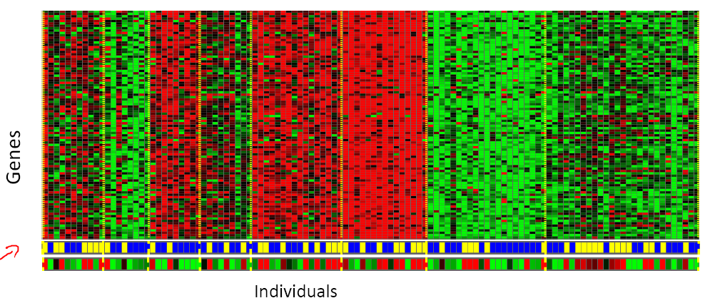

Slide 18
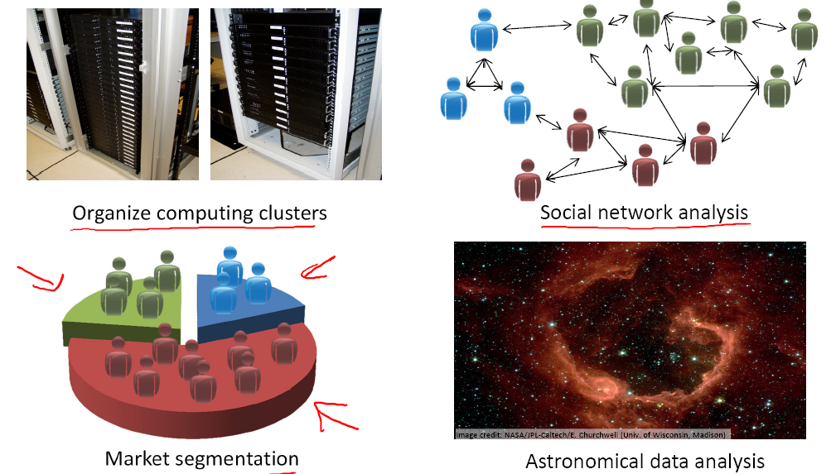

Slide 19
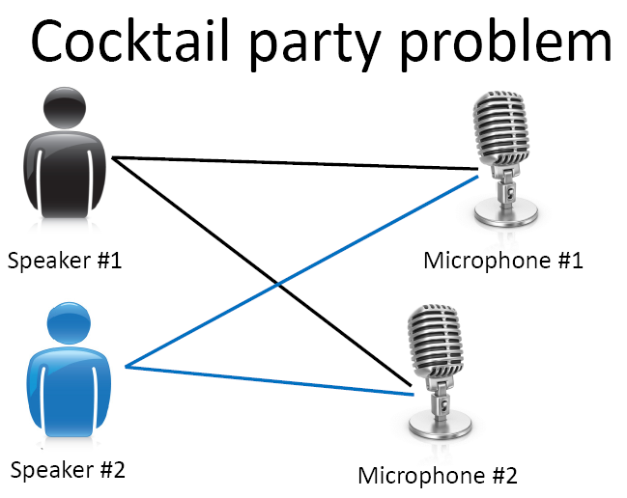
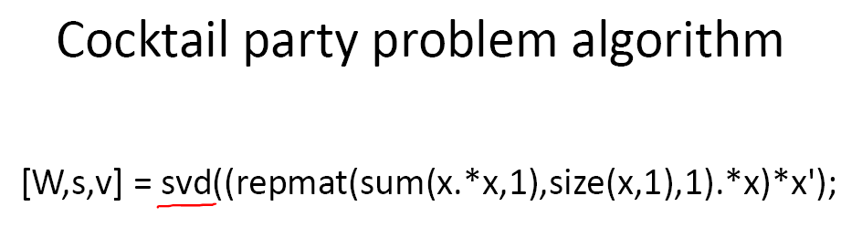

Slide 20
